Slide 1
2 Truths and a Lie
Written by: Selena Ward
Bowie, MD

Slide 2
Instructor Notes
Subject Area(s): ALL
Grade level: 3-12
Lesson Length: As little as one or longer depending on how you run the game.
Synopsis: This is an icebreaker activity to be used at the beginning of the school year. This will allow students to get to know one another and how to use the remote system.
Objective/goals:
- Students will write about their lives in order to introduce themselves to class.
- Students will learn how to use a Turning Point remote in order to play the class introduction game.
Notes:
You can decide to play this game all at once or choose 5 students to focus on each day. If you want to play the game all at once, just duplicate the game slides.

Slide 3
Instructor Notes
Standards: MD Literacy 2.6.c Analyze the text and its information for reliability.
Pre-requisite skills: None
TurningPoint functions: standard question slides and participant leader board slides.
Materials: Index cards
*Instructional delivery notes can be found in the notes section of the slide.

Slide 4
Warm-Up
Put your full name at the top of the card.
On your index card you are going to write three statements about yourself. Two of the statements have to be a true statement and one has to be a lie.
Put a check mark by the statement that is a lie.
Flip your card over when you are done.
Notes:
Encourage students to not make their lie too outrageous that everyone can figure it out. You could even do your own index card as an example.
After they complete the warm-up, collect the cards and move on to another topic or assignment. You can build the game while the students are working or play the game the following day.
If you are in a computer lab you could have the students build their own slide in PowerPoint and then submit it by email, Blackboard, Moodle, Etc.

Slide 5
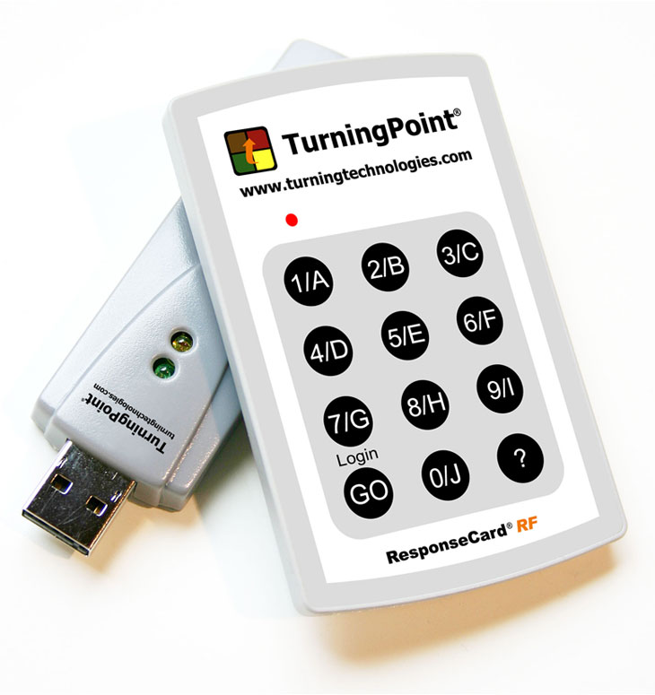
How the Remote Works
2
3
1
4
Notes:
This is connected to my laptop to collect your answers. You do not have to point at the device for it to collect your answer.
This light flashes in two colors: red and green. When you are answering make sure your remote flashes green.
If you notice that each button has a letter and a number. This is for different types of

Slide 6
Let’s Play
2 Truths and a Lie
On your remote press Go, 4, 1, Go
to get a green light.

Slide 7
Student One
Truth
Lie
Truth
Answer Now
:10
Notes:
This slide is designed so you can input the information quickly.

Slide 8
Student Two
Lie
Truth
Truth
Answer Now
:10
Notes:
This slide is designed so you can input the information quickly.

Slide 9
Who is in the lead?
0 | Participant 1
0 | Participant 2
0 | Participant 3
0 | Participant 4
0 | Participant 5

Slide 10
Student Three
Truth
Truth
Lie
Answer Now
:10
Notes:
This slide is designed so you can input the information quickly.

Slide 11
Student Four
Truth
Truth
Lie
Answer Now
:10
Notes:
This slide is designed so you can input the information quickly.

Slide 12
Student Five
Truth
Lie
Truth
Answer Now
:10
Notes:
This slide is designed so you can input the information quickly.

Slide 13
Let’s See Where We Stand
0 | Participant 1
0 | Participant 2
0 | Participant 3
0 | Participant 4
0 | Participant 5

Slide 14
Think about it…
What were you most
surprised to find out
about your classmates?
Think of an example.

